Slide 1
Stack

Slide 2
What is Stack?
A stack is a linear data structure in which the insertion of a new element and removal of an existing element takes place at the same end represented as the top of the stack.
The order may be LIFO(Last In First Out) or FILO(First In Last Out). LIFO implies that the element that is inserted last, comes out first and FILO implies that the element that is inserted first, comes out last.
To implement the stack, it is required to maintain the pointer to the top of the stack, which is the last element to be inserted because we can access the elements only on the top of the stack.

Slide 3
بسته به تعریف عملیات، لیست میتواند نشان دهنده ی ساختار داده های دیگرشود (بسته به مکان درج و حذف یک عنصر.)
اگرتنها از یک انتهای لیست مجاز به برداشتن یک عنصر باشیم و از همان انتها مجاز به قرار دادن یک عنصر باشیم به ساختار داده پشته stack میگوییم
اگرمجاز باشیم از یک انتهای لیست یک عنصر برداریم و در انتهای دیگر یک عنصر قرار دهیم به لیست صف queue میگوییم

Slide 4
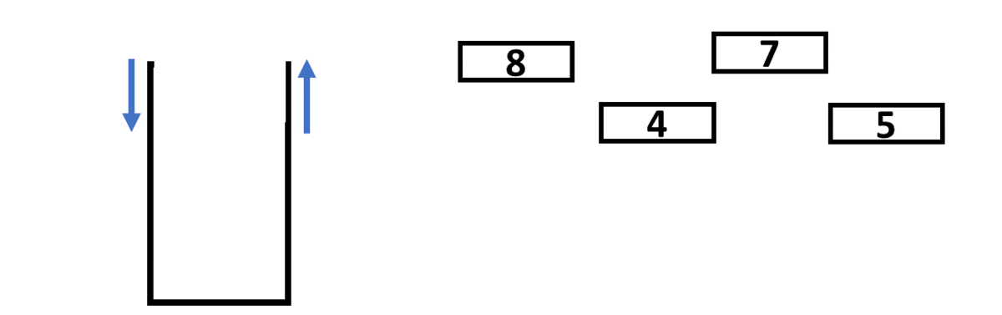
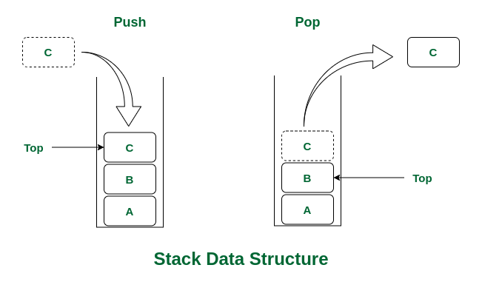

Slide 5
Basic Operations on Stack
In order to make manipulations in a stack, there are certain operations provided to us.
push() to insert an element into the stack
pop() to remove an element from the stack
top() OR peek() Returns the top element of the stack.
isEmpty() returns true if stack is empty else false. { return ( top == -1) ; }
isFull() returns true if stack is full else false. { return ( top == MAX-SIZE-1) ; }
size() returns the size of stack. { return top+1 ; }

Slide 6
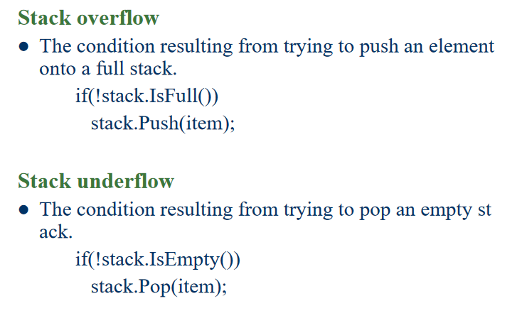

Slide 7
Implementation of Stack:
Using array
In an array-based implementation, the push operation is implemented by incrementing the index of the top element and storing the new element at that index. The pop operation is implemented by decrementing the index of the top element and returning the value stored at that index.
Using linked list
In a linked list-based implementation, the push operation is implemented by creating a new node with the new element and setting the next pointer of the current top node to the new node. The pop operation is implemented by setting the next pointer of the current top node to the next node and returning the value of the current top node.

Slide 8
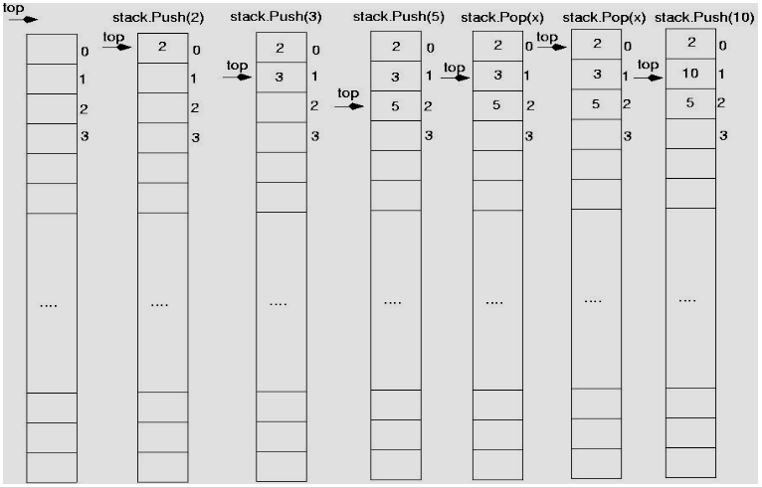
Array-based implementation

Slide 9
Array-based implementation
class Stack {
int top;
public:
int a[MAX]; // Maximum size of Stack
Stack() { top = -1; }
bool push(int x);
int pop();
int peek();
bool isEmpty();
bool isFull();
};

Slide 10
Array-based implementation
bool Stack::push(int x)
{
if (isFull())
throw FullStackException;
else {
a[++top] = x;
cout << x << " pushed into stack\n";
return true;
}
}

Slide 11
Array-based implementation
int Stack::pop()
{
if (isEmpty())
throw EmptyStackException;
else {
int x = a[top--];
return x;
}
}

Slide 12
Array-based implementation
Advantages of array implementation:
Easy to implement.
Memory is saved as pointers are not involved.
Disadvantages of array implementation:
It is not dynamic i.e., it doesn’t grow and shrink depending on needs at runtime.
The total size of the stack must be defined beforehand

Slide 13
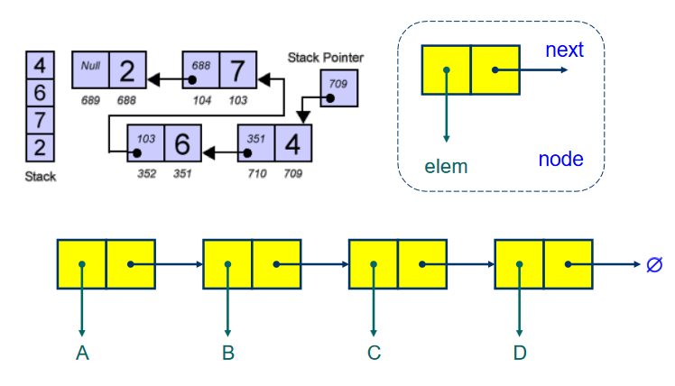
Linked list-based implementation

Slide 14
Linked list-based implementation
Class Node {
public:
int data;
Node* next;
Node(int new_data) {
this->data = new_data;
this->next = nullptr;
}
};
// Class to implement stack using a singly linked list
Class Stack {
// head of the linked list
Node* head;
public:
// Constructor to initialize the stack
Stack() { this->head = nullptr; }
// Function to check if the stack is empty
bool isEmpty() {
// If head is nullptr, the stack is empty
return head == nullptr;
}

Slide 15
Linked list-based implementation
// Function to push an element onto the stack
void push(int new_data) {
// Create a new node with given data
Node* new_node = new Node(new_data);
// Check if memory allocation for the new node
// failed
if (!new_node) {
cout << "\nStack Overflow";
}
// Link the new node to the current top node
new_node->next = head;
// Update the top to the new node
head = new_node;
}

Slide 16
Linked list-based implementation
// Function to remove the top element from the stack
void pop() {
// Check for stack underflow
if (this->isEmpty()) {
cout << "\nStack Underflow" << endl;
}
else {
// Assign the current top to a temporary
// variable
Node* temp = head;
// Update the top to the next node
head = head->next;
// Deallocate the memory of the old top node
delete temp;
}

Slide 17
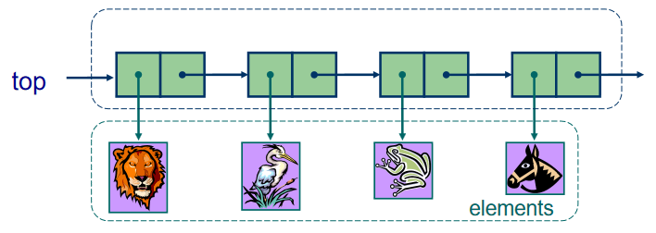
Linked list-based implementation

Slide 18
Linked list-based implementation
Advantages of Linked List implementation:
The linked list implementation of a stack can grow and shrink according to the needs at runtime.
Disadvantages of Linked List implementation:
Requires extra memory due to the involvement of pointers.
Random accessing is not possible in stack.

Slide 19
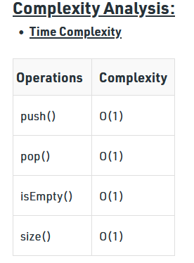

Slide 20
کاربرد پشته
تطبیق پرانتزها
پردازش XHTML
ارزیابی عبارات محاسباتی

Slide 21
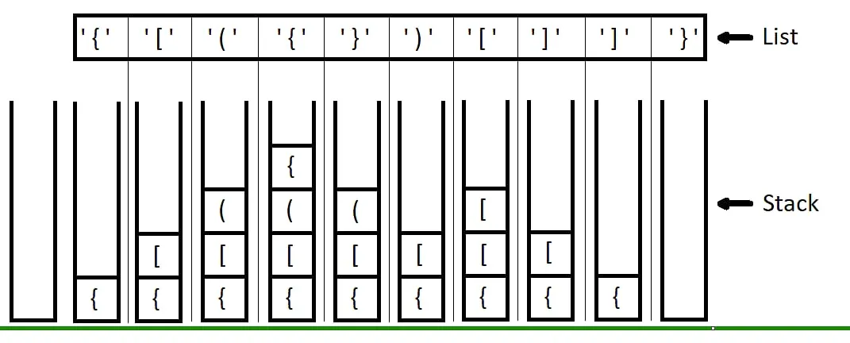
تطبیق پرانتزها
Check for Balanced Bracket expression using Stack

Slide 22
تطبیق پرانتزها
Declare a character stack (say temp).
Now traverse the string exp.
If the current character is a starting bracket ( ‘(‘ or ‘{‘ or ‘[‘ ) then push it to stack.
If the current character is a closing bracket ( ‘)’ or ‘}’ or ‘]’ ) then pop from stack and if the popped character is the matching starting bracket then fine.
Else brackets are Not Balanced.
After complete traversal, if there is some starting bracket left in stack then Not balanced, else Balanced.

Slide 23
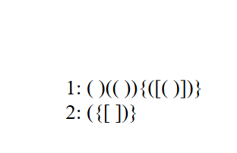
تطبیق پرانتزها
حل کنید

Slide 24
Parsing XHTML
The next example will demonstrate parsing XHTML
We will show how stacks may be used to parse an XHTML document
You will use XHTML (and more generally XML and other markup languages) in the workplace

Slide 25
Parsing XHTML
A markup language is a means of annotating a document to given context to the text
The annotations give information about the structure or presentation of the text
The best known example is HTML, or HyperText Markup Language
We will look at XHTML

Slide 26
Parsing XHTML
XHTML is made of nested
opening tags, e.g., <some_identifier>, and
matching closing tags, e.g., </some_identifier>
<html>
<head><title>Hello</title></head>
<body><p>This appears in the <i>browser</i>.</p></body>
</html>

Slide 27
Parsing XHTML
Nesting indicates that any closing tag must match the most recent opening tag
Strategy for parsing XHTML:
read though the XHTML linearly
place the opening tags in a stack
when a closing tag is encountered, check that it matches what is on top of the stack and

Slide 28
Parsing XHTML
<html>
<head><title>Hello</title></head>
<body><p>This appears in the <i>browser</i>.</p></body>
</html>
<html>

Slide 29
Parsing XHTML
<html>
<head><title>Hello</title></head>
<body><p>This appears in the <i>browser</i>.</p></body>
</html>
<html> | <head>

Slide 30
Parsing XHTML
<html>
<head><title>Hello</title></head>
<body><p>This appears in the <i>browser</i>.</p></body>
</html>
<html> | <head> | <title>

Slide 31
Parsing XHTML
<html>
<head><title>Hello</title></head>
<body><p>This appears in the <i>browser</i>.</p></body>
</html>
<html> | <head> | <title>

Slide 32
Parsing XHTML
<html>
<head><title>Hello</title></head>
<body><p>This appears in the <i>browser</i>.</p></body>
</html>
<html> | <head>

Slide 33
Parsing XHTML
<html>
<head><title>Hello</title></head>
<body><p>This appears in the <i>browser</i>.</p></body>
</html>
<html> | <body>

Slide 34
Parsing XHTML
<html>
<head><title>Hello</title></head>
<body><p>This appears in the <i>browser</i>.</p></body>
</html>
<html> | <body> | <p>

Slide 35
Parsing XHTML
<html>
<head><title>Hello</title></head>
<body><p>This appears in the <i>browser</i>.</p></body>
</html>
<html> | <body> | <p> | <i>

Slide 36
Parsing XHTML
<html>
<head><title>Hello</title></head>
<body><p>This appears in the <i>browser</i>.</p></body>
</html>
<html> | <body> | <p> | <i>

Slide 37
Parsing XHTML
<html>
<head><title>Hello</title></head>
<body><p>This appears in the <i>browser</i>.</p></body>
</html>
<html> | <body> | <p>

Slide 38
Parsing XHTML
<html>
<head><title>Hello</title></head>
<body><p>This appears in the <i>browser</i>.</p></body>
</html>
<html> | <body>

Slide 39
Parsing XHTML
<html>
<head><title>Hello</title></head>
<body><p>This appears in the <i>browser</i>.</p></body>
</html>
<html>

Slide 40
Parsing XHTML
We are finished parsing, and the stack is empty
Possible errors:
a closing tag which does not match the opening tag on top of the stack
a closing tag when the stack is empty
the stack is not empty at the end of the document

Slide 41
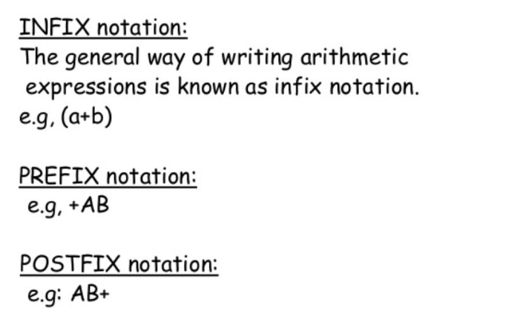
انواع نمایش عملیات محاسباتی

Slide 42
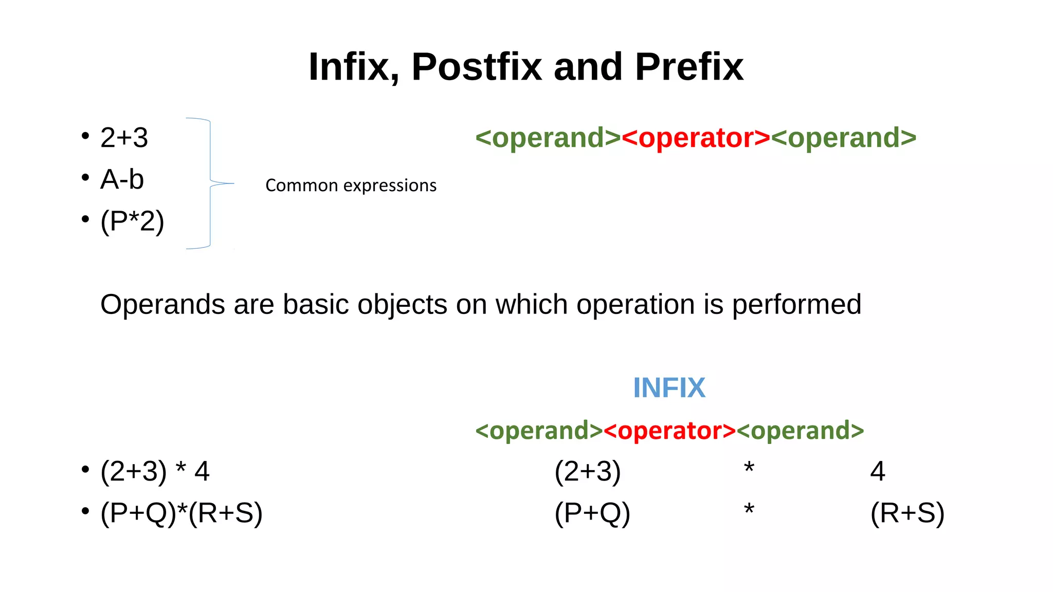
انواع نمایش عملیات محاسباتی

Slide 43
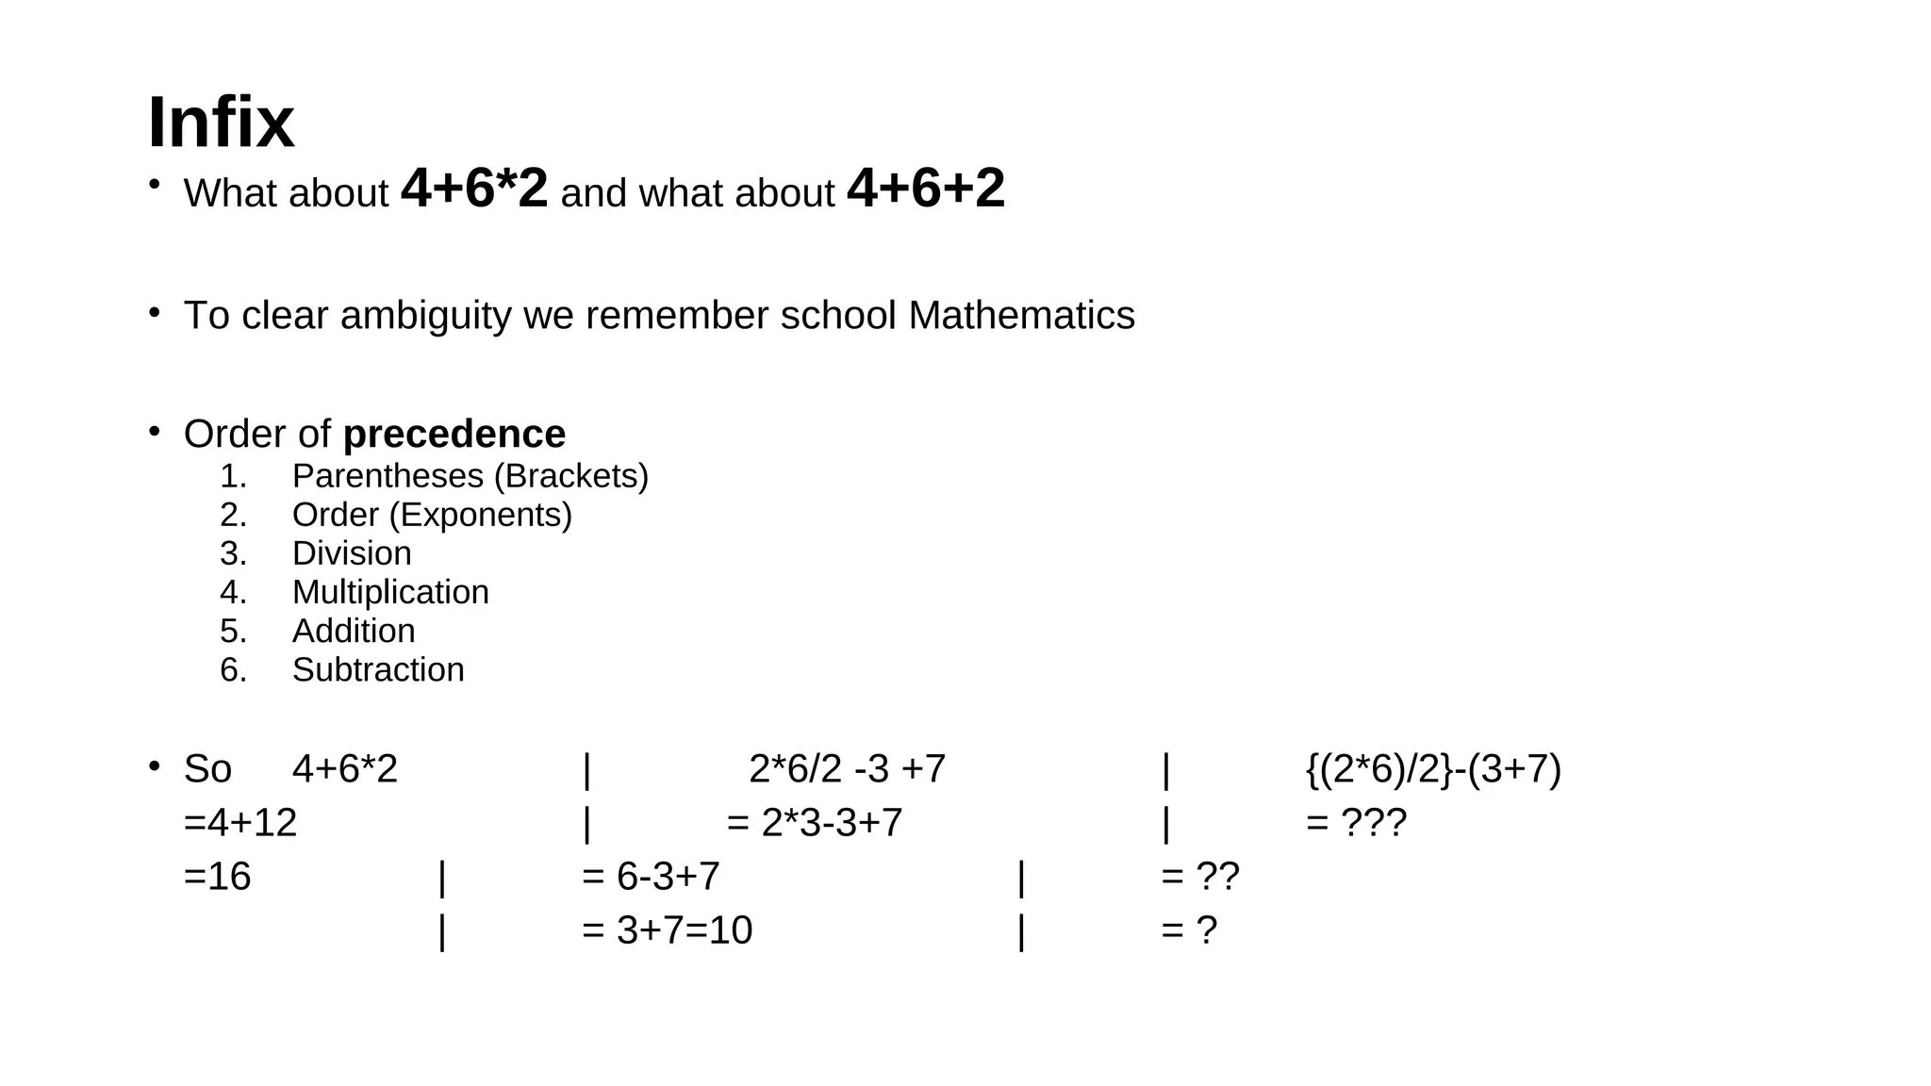

Slide 44
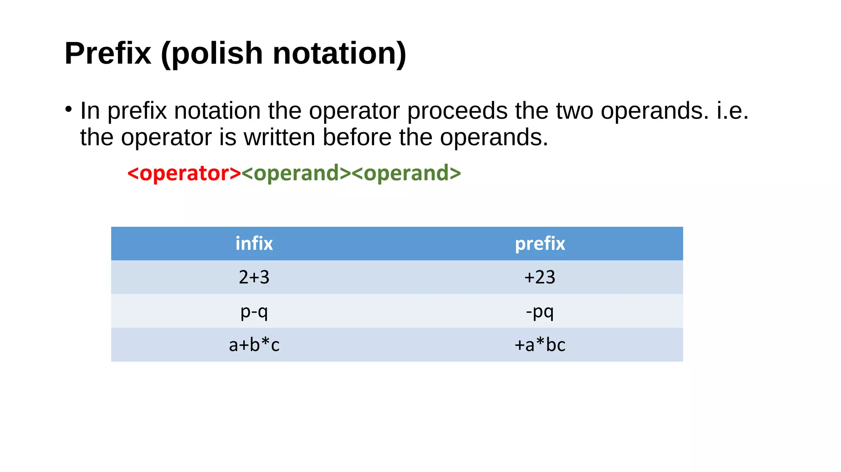

Slide 45
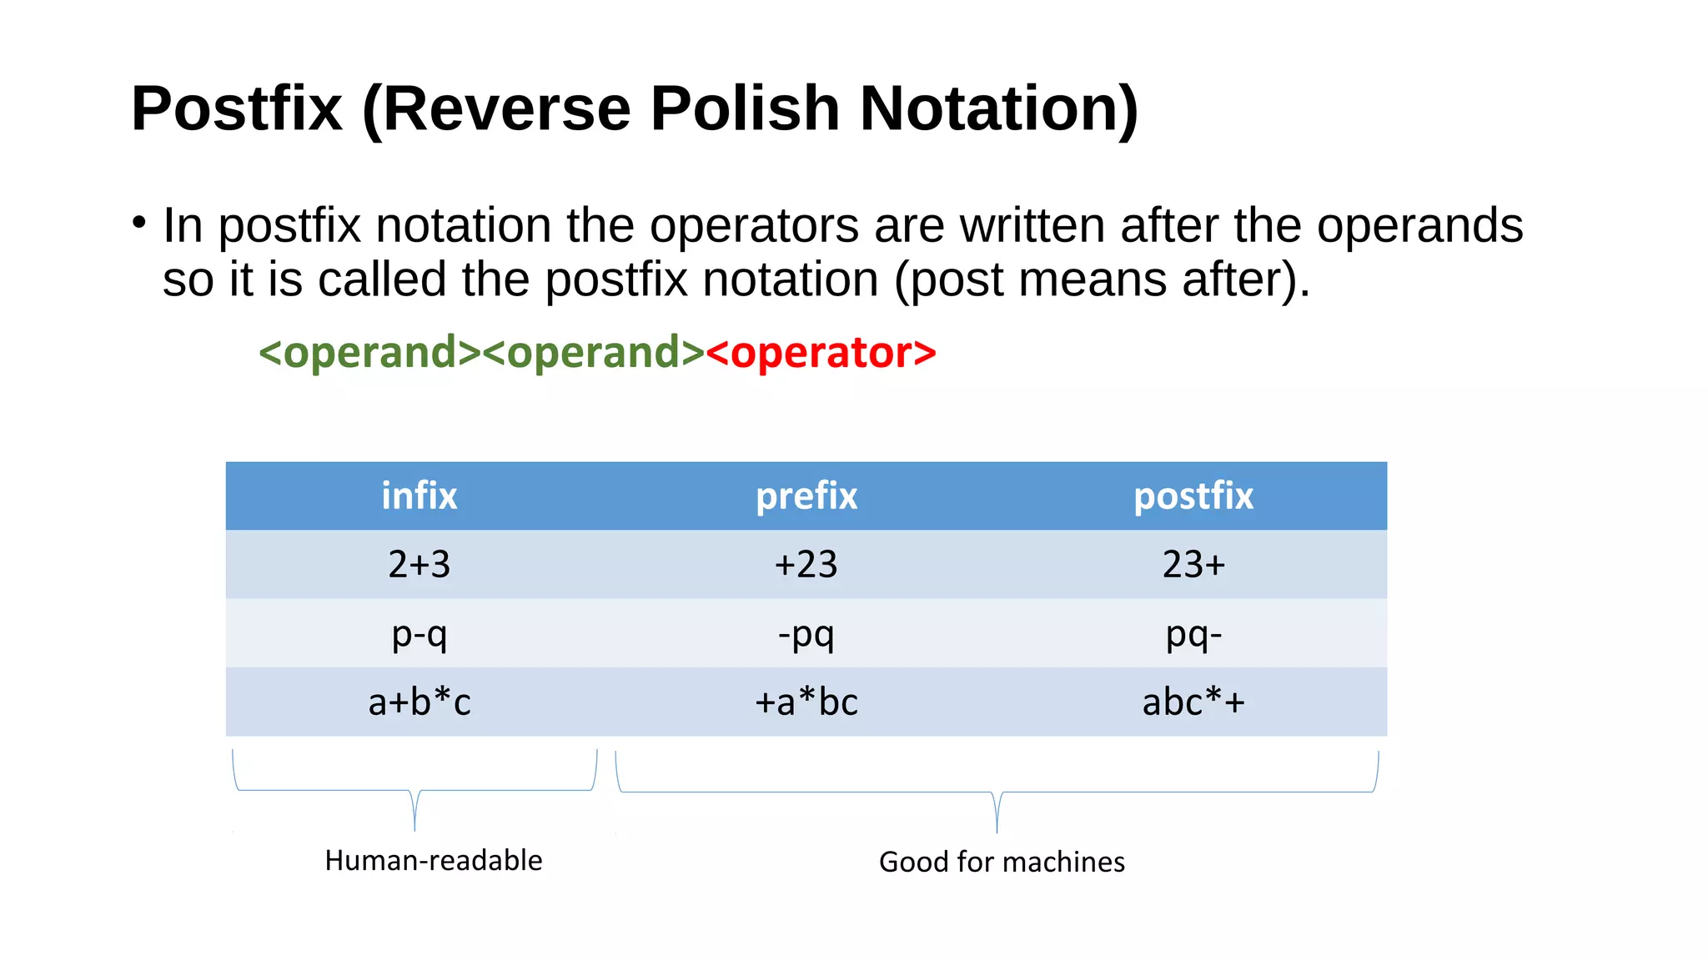

Slide 46
انواع نمایش عملیات محاسباتی
عبارات Prefix وPostfix را می توان سریعتر از یک عبارتinfix ارزیابی کرد.
به این دلیل که نیازی به پردازش براکت یا پیروی از قانون اولویت عملگر وجود ندارد.
در عبارات پسوندی و پیشوندی که هر عملگری که در ابتدا آمده باشد، بدون در نظر گرفتن اولویت، ابتدا ارزیابی می شود.
One weakness: parentheses are required
(3 + 4) × 5 – 6 = 29
3 + 4 × 5 – 6 = 17
3 + 4 × (5 – 6) = –1
(3 + 4) × (5 – 6) = –7

Slide 47
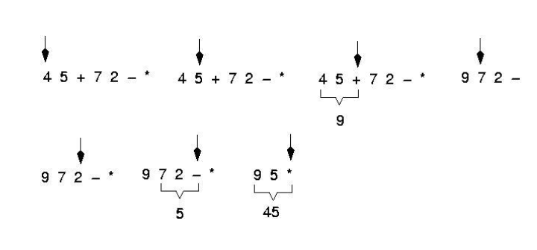
Postfix Evaluation
Expressions are evaluated from left to right

Slide 48
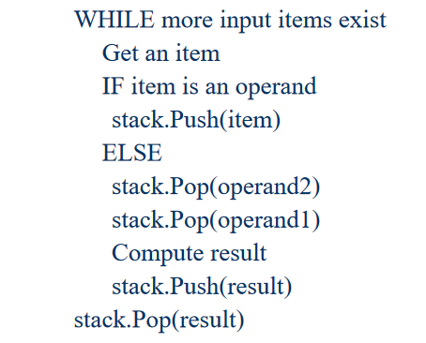
Postfix expressions: Algorithm using stacks

Slide 49
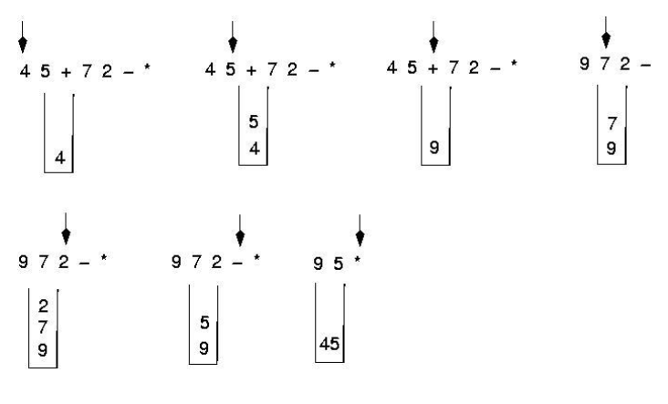
Postfix expressions: Algorithm using stacks

Slide 50
Reverse-Polish Notation
Evaluate the following reverse-Polish expression using a stack:
1 2 3 + 4 5 6 × – 7 × + – 8 9 × +

Slide 51
Reverse-Polish Notation
Push 1 onto the stack
1 2 3 + 4 5 6 × – 7 × + – 8 9 × +
1

Slide 52
Reverse-Polish Notation
Push 1 onto the stack
1 2 3 + 4 5 6 × – 7 × + – 8 9 × +
2
1

Slide 53
Reverse-Polish Notation
Push 3 onto the stack
1 2 3 + 4 5 6 × – 7 × + – 8 9 × +
3
2
1

Slide 54
Reverse-Polish Notation
Pop 3 and 2 and push 2 + 3 = 5
1 2 3 + 4 5 6 × – 7 × + – 8 9 × +
5
1

Slide 55
Reverse-Polish Notation
Push 4 onto the stack
1 2 3 + 4 5 6 × – 7 × + – 8 9 × +
4
5
1

Slide 56
Reverse-Polish Notation
Push 5 onto the stack
1 2 3 + 4 5 6 × – 7 × + – 8 9 × +
5
4
5
1

Slide 57
Reverse-Polish Notation
Push 6 onto the stack
1 2 3 + 4 5 6 × – 7 × + – 8 9 × +
6
5
4
5
1

Slide 58
Reverse-Polish Notation
Pop 6 and 5 and push 5 × 6 = 30
1 2 3 + 4 5 6 × – 7 × + – 8 9 × +
30
4
5
1

Slide 59
Reverse-Polish Notation
Pop 30 and 4 and push 4 – 30 = –26
1 2 3 + 4 5 6 × – 7 × + – 8 9 × +
–26
5
1

Slide 60
Reverse-Polish Notation
Push 7 onto the stack
1 2 3 + 4 5 6 × – 7 × + – 8 9 × +
7
–26
5
1

Slide 61
Reverse-Polish Notation
Pop 7 and –26 and push –26 × 7 = –182
1 2 3 + 4 5 6 × – 7 × + – 8 9 × +
–182
5
1

Slide 62
Reverse-Polish Notation
Pop –182 and 5 and push –182 + 5 = –177
1 2 3 + 4 5 6 × – 7 × + – 8 9 × +
–177
1

Slide 63
Reverse-Polish Notation
Pop –177 and 1 and push 1 – (–177) = 178
1 2 3 + 4 5 6 × – 7 × + – 8 9 × +
178

Slide 64
Reverse-Polish Notation
Push 8 onto the stack
1 2 3 + 4 5 6 × – 7 × + – 8 9 × +
8
178

Slide 65
Reverse-Polish Notation
Push 1 onto the stack
1 2 3 + 4 5 6 × – 7 × + – 8 9 × +
9
8
178

Slide 66
Reverse-Polish Notation
Pop 9 and 8 and push 8 × 9 = 72
1 2 3 + 4 5 6 × – 7 × + – 8 9 × +
72
178

Slide 67
Reverse-Polish Notation
Pop 72 and 178 and push 178 + 72 = 250
1 2 3 + 4 5 6 × – 7 × + – 8 9 × +
250

Slide 68
Reverse-Polish Notation
Thus
1 2 3 + 4 5 6 × – 7 × + – 8 9 × +
evaluates to the value on the top: 250
The equivalent in-fix notation is
((1 – ((2 + 3) + ((4 – (5 × 6)) × 7))) + (8 × 9))
We reduce the parentheses using order-of-operations:
1 – (2 + 3 + (4 – 5 × 6) × 7) + 8 × 9

Slide 69
Infix to Postfix
1-ابتدا infix را از چپ به راست پیمایش می کنیم
2-پرانتز باز را به پشته push می کنیم
3-به عملوند که رسیدیم آنرا در خروجی مینویسیم
4-اگر به یک عملگر رسیدیم آنرا به پشته push می کنیم، با این شرط که اگر قبل از آن در پشته عملگری با اولویت بالاتر یا هم اولویت این عملگر وجود داشت آنگاه ابتدا آن عملگر ها را از پشته pop میکنیم و در خروجی می نویسیم.
5-اگر به پرانتز بسته رسیدیم .هر عملگری در پشته وجود داشت pop می کنیم تا به یک پرانتز باز برسیم و سپس آن پرانتز باز را از پشته حذف میکنیم.

Slide 70
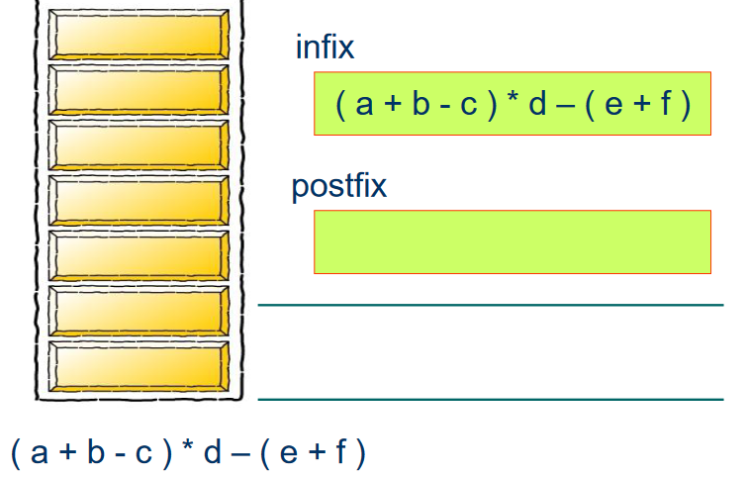
Infix to Postfix

Slide 71
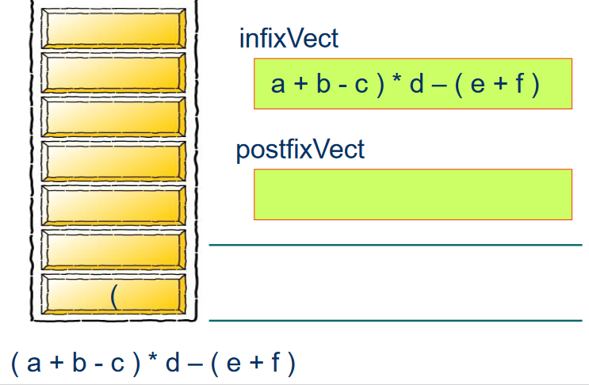
Infix to Postfix

Slide 72
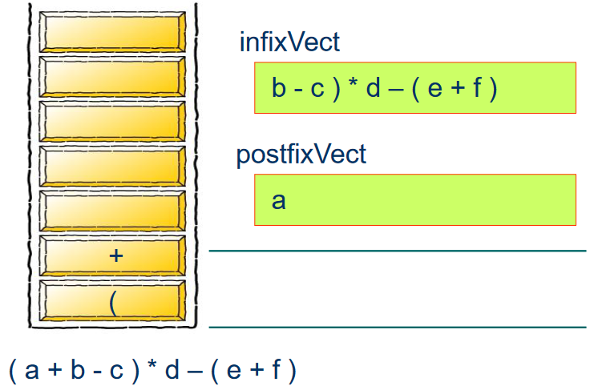
Infix to Postfix

Slide 73
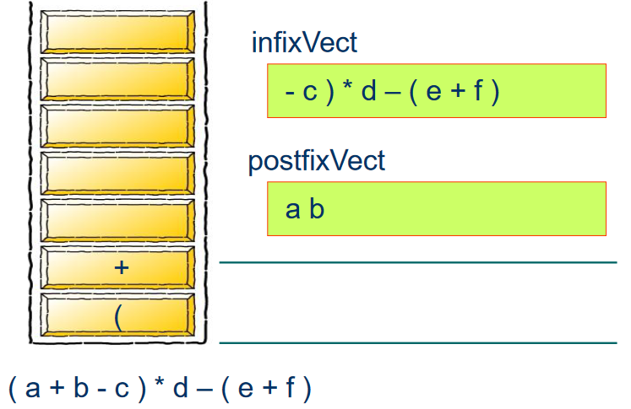
Infix to Postfix

Slide 74

Infix to Postfix

Slide 75
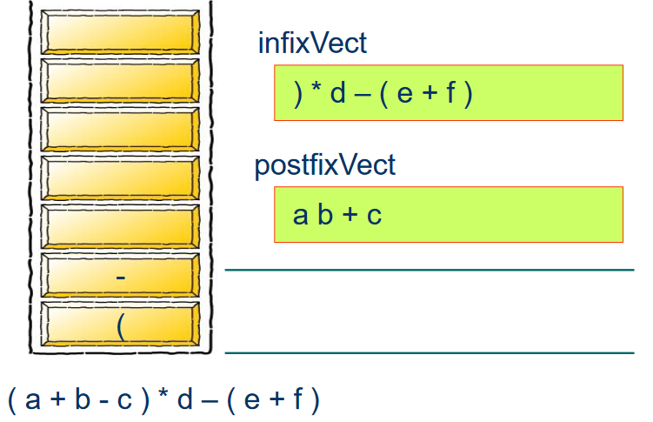
Infix to Postfix

Slide 76
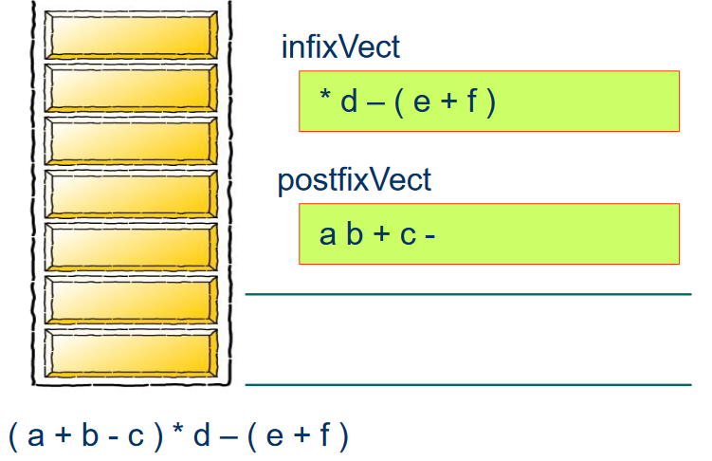
Infix to Postfix

Slide 77
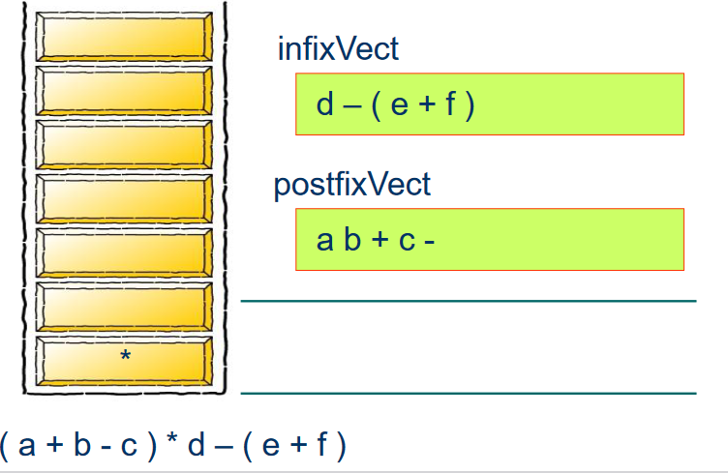
Infix to Postfix

Slide 78
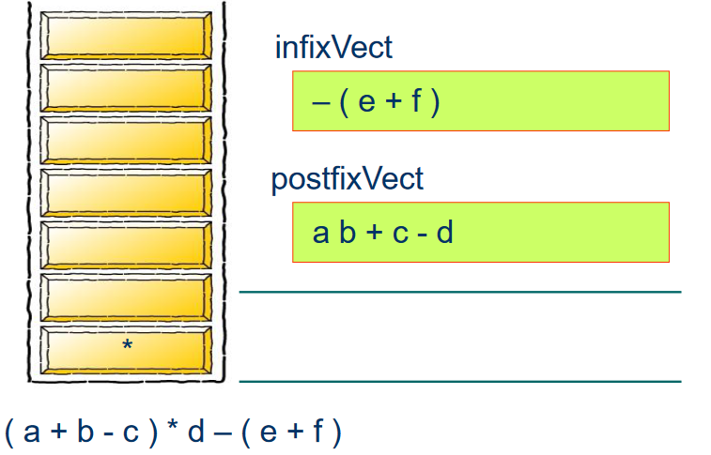
Infix to Postfix

Slide 79
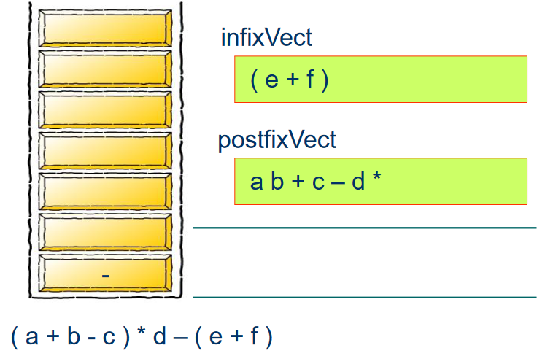
Infix to Postfix

Slide 80
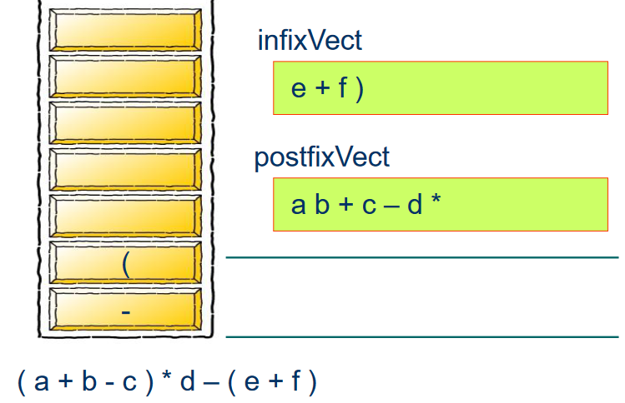
Infix to Postfix

Slide 81
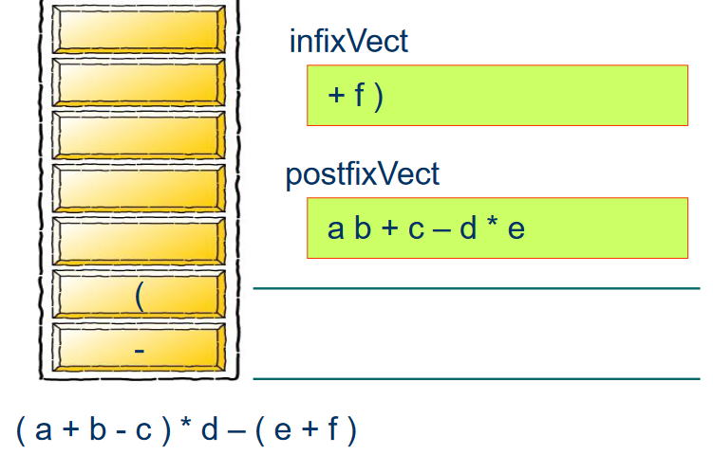
Infix to Postfix

Slide 82
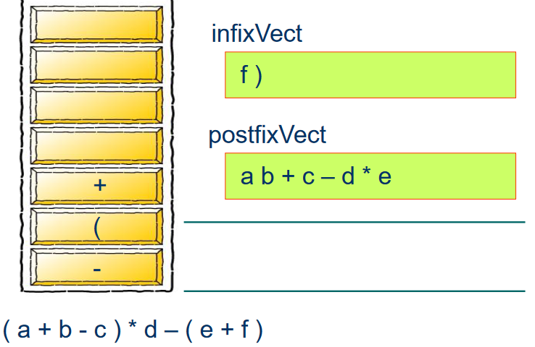
Infix to Postfix

Slide 83
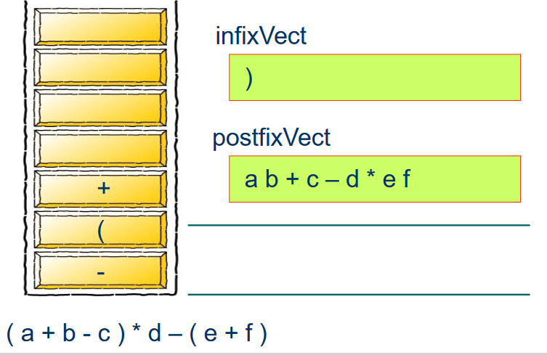
Infix to Postfix

Slide 84
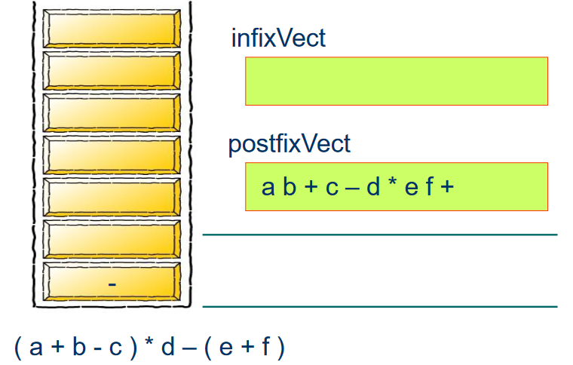
Infix to Postfix

Slide 85
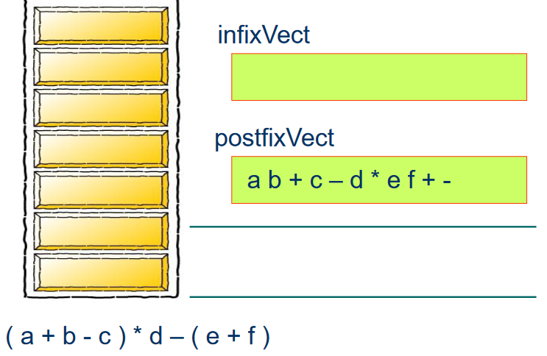
Infix to Postfix

Slide 86
Infix to Postfix
Exercise: convert the infix expression to postfix
a+b*(c^d-e)^(f+g*h)-i
Notes:
abcd^e-fgh*+^*+i-

Slide 87
Infix to Postfix
Exercise: convert the infix expression to postfix
a+b*(c^d-e)^(f+g*h)-i
abcd^e-fgh*+^*+i-
Notes:
abcd^e-fgh*+^*+i-

Slide 88
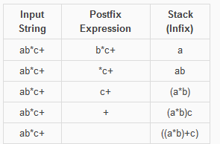
Postfix to Infix
Scan the given postfix expression from left to right character by character.
If the character is an operand, push it into the stack.
But if the character is an operator, pop the top two values from stack.
Concatenate this operator with these two values (2nd top value+operator+1st top value) to get a new string.
Now push this resulting string back into the stack.
Repeat this process until the end of postfix expression. Now the value in the stack is the infix expression.
Notes:
abcd^e-fgh*+^*+i-

